Slide 1

Federated Cloud Architecture
Shakti Mishra

Slide 2
Federation in Cloud
Cloud computing offers computing resources such as servers, databases, storage, networking, runtime environment, virtualization, & software to its customer on their demand over the internet. Customers consume these cloud services with pay as you go pricing model.
Federated cloud is formed by connecting the cloud environment of several cloud providers using a common standard. This federation in the cloud helps the provider to easily scale up the resource to match business needs.

Slide 3
Definition
“Cloud federation manages consistency and access controls when two or more independent geographically distinct Clouds share either authentication, files, computing resources, command and control or access to storage resources.”

Slide 4
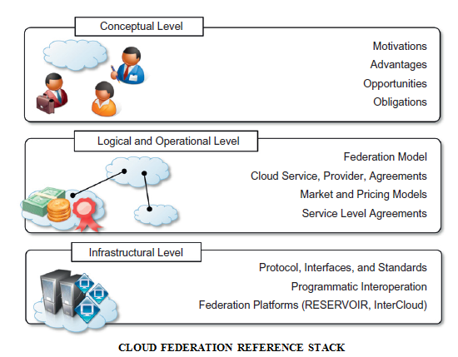
Cloud Federation Reference Stack

Slide 5
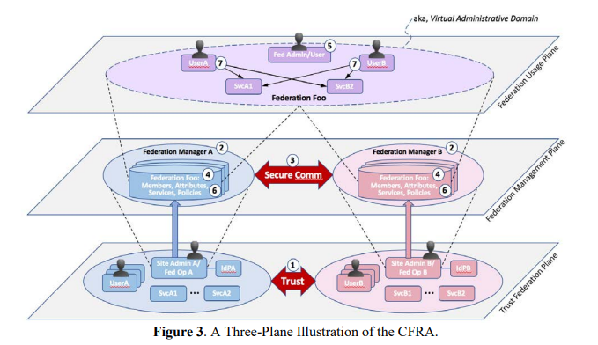
Three Plane reference CFRA

Slide 6
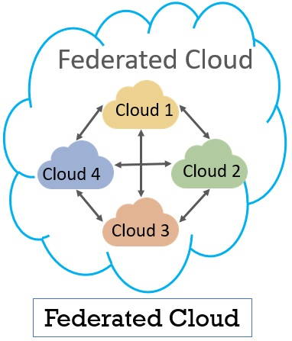
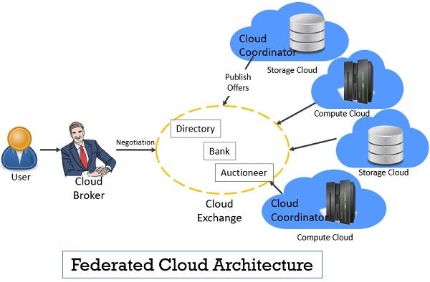

Slide 7
Federated Cloud Architecture: Components
Cloud Broker
On behalf of the customer, it is the cloud broker who interacts with the cloud coordinator, analyzes the SLA agreement, resources offered by different cloud providers in cloud exchange.
Cloud broker finalizes the most appropriate deal for their client.
Following are the services offered by cloud exchange to both cloud broker and cloud coordinator.
Database Repository: Cloud exchange act as a database repository or directory where cloud broker announces their resources, service and the price they offer for the services. The customer then analyze this repository to search the most appropriate service and price suiting them and place a request for the service
Dealer: The cloud exchanger always updates policies of its participants; they always act as a third party between broker and coordinator.
Bank: Cloud exchanger facilitates the financial transaction between cloud vendors and its clients thus maintaining the trust.

Slide 8
Federated Cloud Architecture: Components
Cloud Exchange
Acts as a moderator between cloud coordinator and cloud broker.
Maps the demands of the cloud broker to the available services offered by the coordinator.
Tracks the record of what is the current cost, demand patterns and available cloud providers and this information is periodically updated by the cloud coordinator.
Cloud Coordinator
Manages the cloud enterprises and their membership.
Allocates the cloud resources to the remote users based on the quality of service they demand and the credits they have in the cloud bank.
Based on the policies of SLA the marketing and pricing policies are developed by the cloud coordinator.

Slide 9
Cloud Federation Properties (1/3)
Functional Cloud Federation Properties
1. Authentication: Cloud federation has the involvement of several foreign resources that have participated in the federation. To consume these foreign resource customer must be provided with the access credential relevant to the target foreign resource. However, the respective foreign resource must also have authentication information of the customer.
2. Integrity: Integrity in the federated cloud offers and demand consistent resources by the providers participated in the federation.
Solution:
Designate a federation administrative board or the provider can automate the process which will trigger the administrative action when any irregularity is detected.

Slide 10
Cloud Federation Properties(2/3)
3. Monitoring: Federated cloud can be monitored in two ways global monitoring and monitoring as a service (MaaS). Global monitoring aids in maintaining the federated cloud. MaaS provides information that helps in tracking contracted services to the customer.
4. Object: Marketing object in cloud computing are infrastructure, software, platform that are offered to the customer as a service. These objects have to pass through federation when consumed in the federated cloud.
5. Contracts: In addition to regular SLA, federated cloud has a federation level agreement that encloses commitment to the functional and usage properties.

Slide 11
Cloud Federation Properties (3/3)
6. Provisioning: Allocating services and resources offered by the cloud provider to the customer through federation. It can be done manually or automatically. In an automatic way, the best provider is chosen to allocate the resources and services to the customer. In the manual way entity in the federation selects the provider to allocate the resources and services.
7. Service Management: Service management discovers and publishes the services offered by the federated cloud.
8. Interoperability: Interoperability is a mechanism with which the customer’s system is able to interact with the cloud service or cloud service in the federation is able to interact with other cloud services.
9. Commercialization: The providers participated in federation publish their offers to a central entity. The customer interacts with this central entity to verify the prices and propose an offer.

Slide 12
Types of Federation in Cloud
Permissive federation Permissive federation allows the interconnection of the cloud environment of two service providers without the verifying identity of peer cloud using DNS lookups. This raises the chances of domain spoofing.
Verified Federation Verified federation allows interconnection of the cloud environment of two service providers, only after the peer cloud is identified using the information obtained from DNS. Though the identity verification prevents spoofing the connection is still not encrypted and there are chances of DNS attack.
Encrypted Federation Encrypted federation allows interconnection of the cloud environment of two services provider only if the peer cloud supports transport layer security (TSL). The peer cloud interested in the federation must provide the digital certificate which still provides mutual authentication. Thus, encrypted federation results in weak identity verification.
Trusted Federation Trusted federation allows two clouds from different provider to connect only under a provision that the peer cloud support TSL along with that it provides a digital certificate authorized by the certification authority (CA) that is trusted by the authenticating cloud.

Slide 13
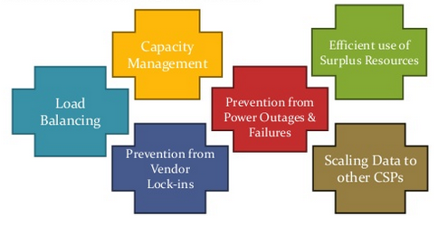
Benefits

Slide 14
Some Federation Use Case Examples
Cloud Infrastructure Federations:
Platform Federations:
Data Federations:

Slide 15
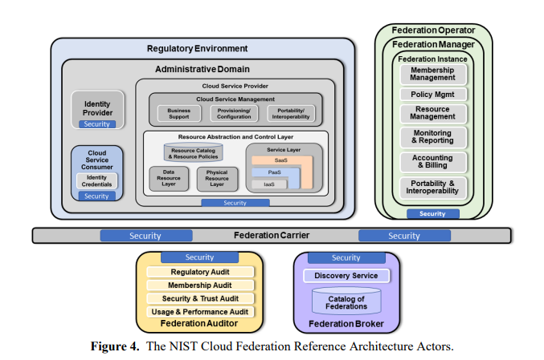
NIST CFRA

